Slide 1

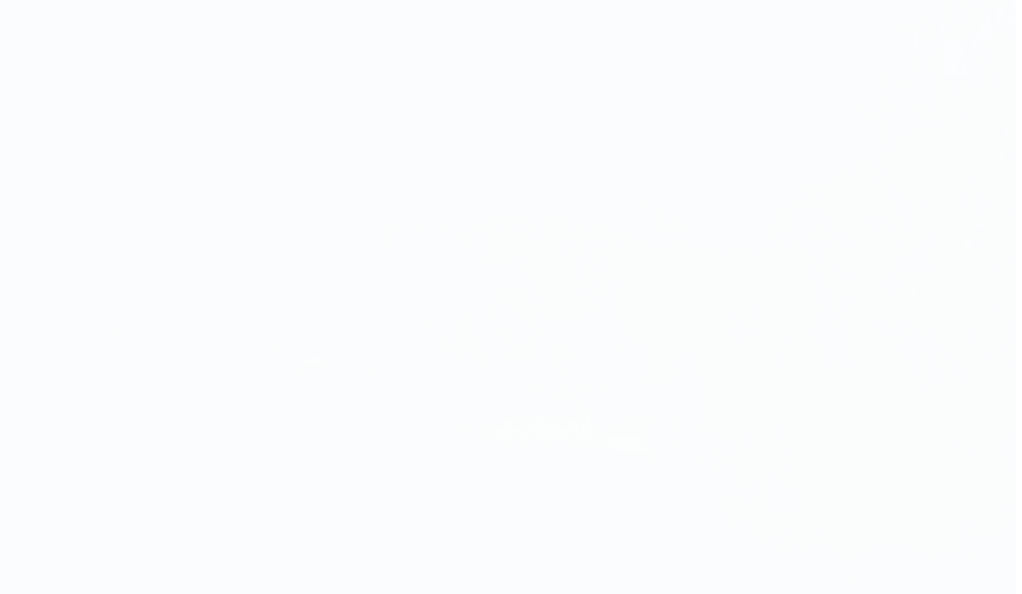

The ClinTox Dataset In Details
by Saranya Pal

Slide 2
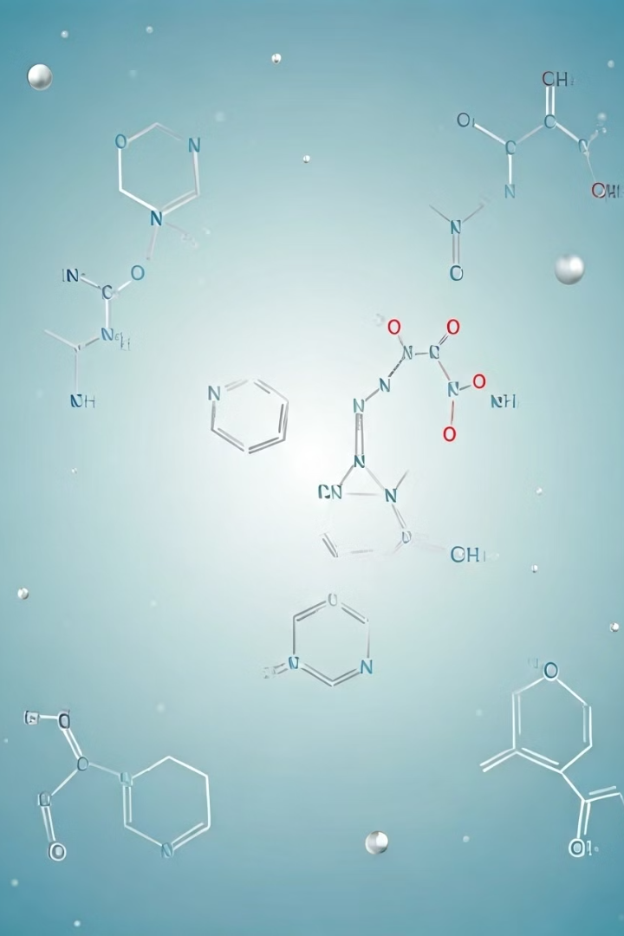
The ClinTox dataset was released as part of the MoleculeNet dataset by the Stanford University to perform and experiment Machine Learning and Computational methods on molecules. Apart from Clintox, MoleculeNet also contains other datasets like Cora etc.
The ClinTox dataset compares drugs approved by the FDA and drugs that have failed clinical trials for toxicity reasons. The dataset includes two classification tasks for 1491 drug compounds with known chemical structures:-
clinical trial toxicity (or absence of toxicity) and
FDA approval status.
The details of MoleculeNet are on the next slide

Slide 3
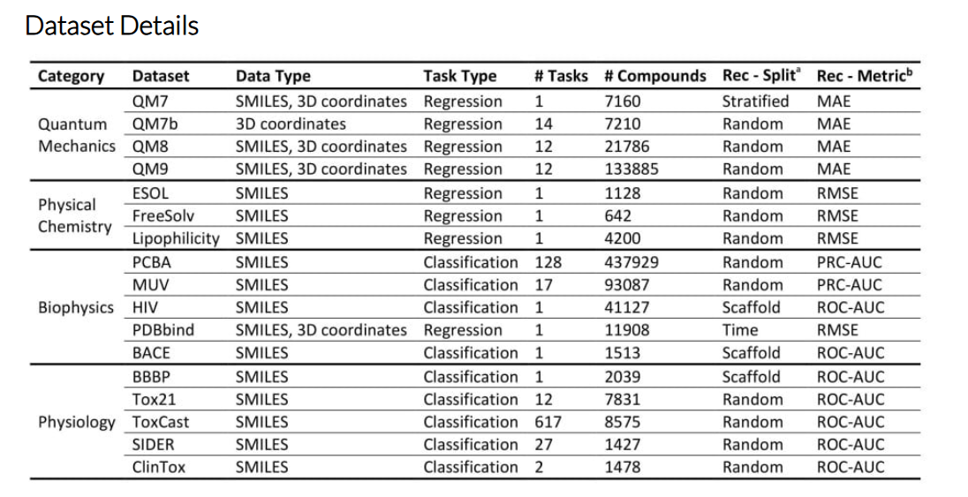

Slide 4
Introduction to the ClinTox Dataset
1
Approved Drugs
2
Clinical Toxicity
The dataset includes information on whether a drug has been approved by the FDA for commercial use.
It also captures data on drugs that have been withdrawn from clinical trials or failed due to toxicity issues.
3
Molecular Representation
The dataset represents drug molecules as graphs using the PyTorch Geometric library, enabling the application of graph-based machine learning techniques.

Slide 5
Dataset Overview: Approved Drugs and Clinical Toxicity
Total Drugs
Clinical Toxicity
FDA Approval
The dataset contains information of 1480 drugs in total including the toxic and the non-toxic drugs.
Out of those drugs, there are 112 total drugs that have been reported toxic. And the rest 1368 are non-toxic
There is another label along with the toxicity label, which is the label for FDA approved status. 1386 molecules are FDA approved and the remaining 94 are not approved by FDA
NOTE:-
Among the 1480 drugs, there are 18 drugs that are toxic but still approved by the FDA

Slide 6
Some more details:-
The molecules/drug are represented in the form of graphs, where every node represents an atom
A certain drug will be composed of several atoms such as Hydrogen(H), Oxygen(O) etc. Each of these atoms (or nodes as in the graph) will have a set of 9 features of itself. These 9 features for every atom in the drug represent the following information:-
Atomic Number
Chirality
Degree
Formal Charge
Count of Hydrogen Atoms
Hybridization
Aromaticity
Atomic Mass
Van Der Waals Radius

Slide 7
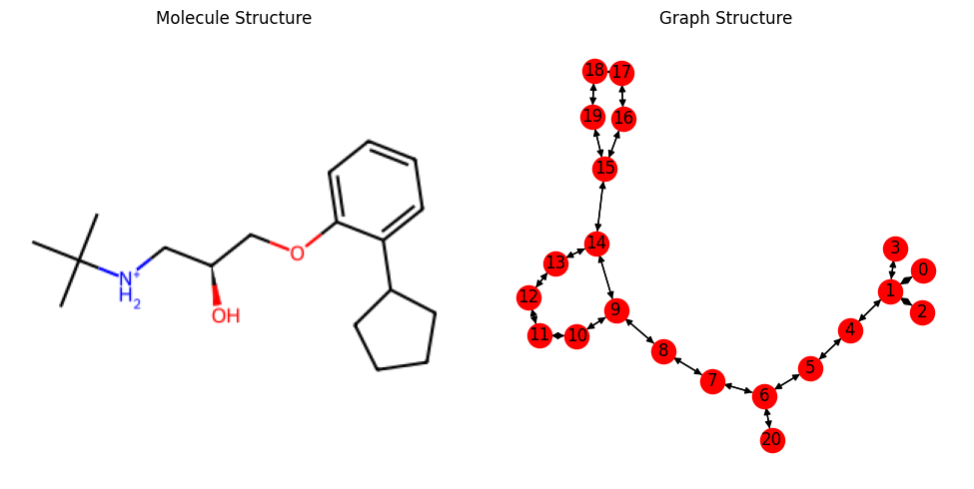
An Example of the previous description:-
This is the pentane ring of the drug as shown in the arrow
This drug is non-toxic
This is the benzene ring of the drug
To get a better understanding, please match the numbers on the graph with the row index of the matrix on the next page. Properties such as atomic no., chirality etc. for every atom are listed

Slide 8
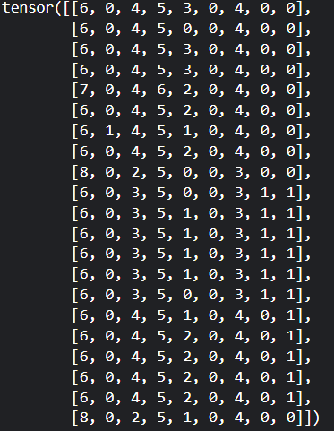
An Example of the previous description:-
This represents the 9 features of the molecule on the last slide. Notice that there are 9 columns, where each column represent the 9 properties as mentioned previously. Also, the index of each row aligns with the numbering of the graph
To get a proper understanding, just match the numbering on the graph with the row index of this matrix.

Slide 9
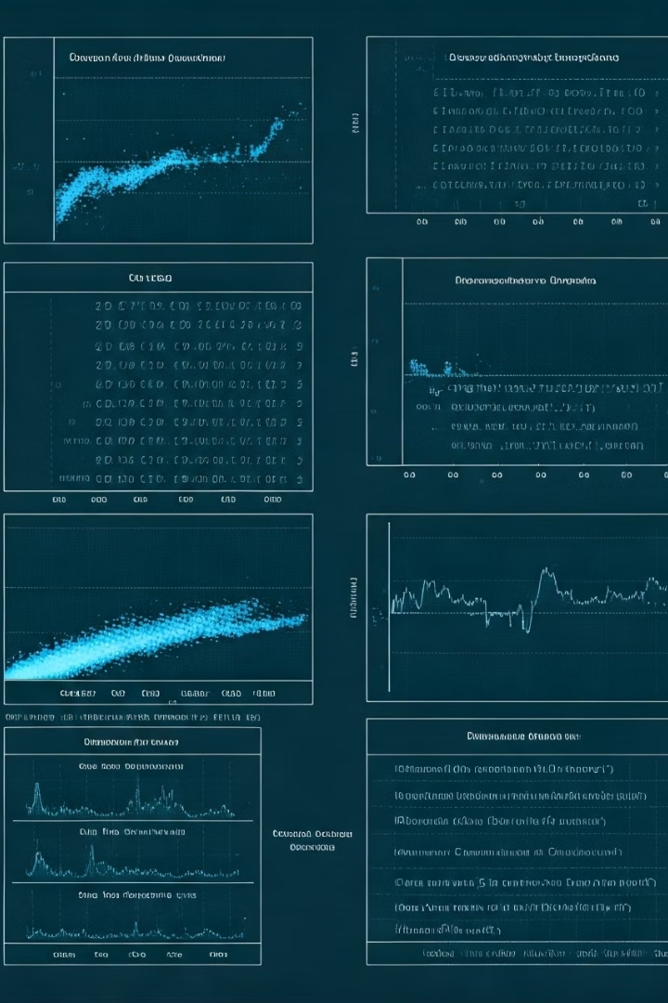




Data Preprocessing (Future Plan)
Are all atoms same?
Data Pre-processing
Correct the graph structure of the atoms (make it a heterogenous graph) and make all the necessary changes
Using SMOTE technique for this highly unbalanced dataset. Then use MaxPool and AvgPool on the matrix shown previously
Graph2Vec and Node2Vec
Model Fitting
Concatenate [MaxPool, AvgPool, Graph2Vec, Node2Vec] together to form a single vector.
Try RGCN and Transformers architecture and also come up with a better architecture that fits better later

Slide 10
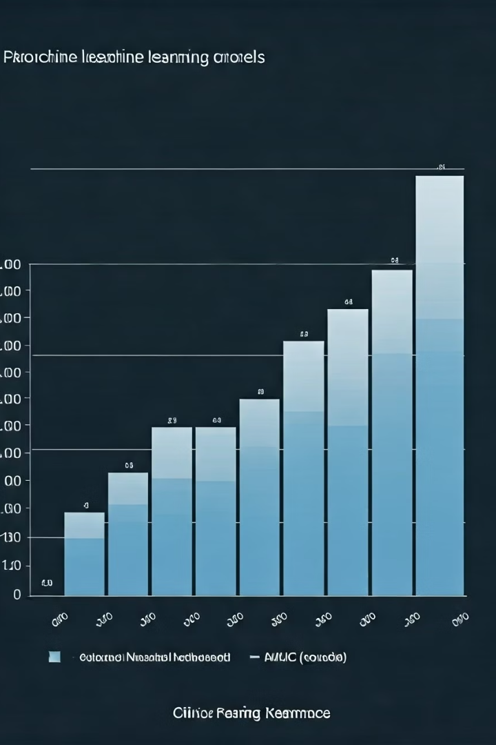

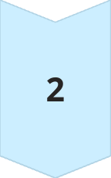
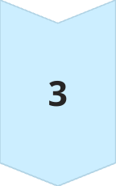
Modeling Approaches for Clintox
Graph Neural Networks
GCN and GAT architecture already tried. RGCN architecture to be tried after proper data pre-processing
Graph Transformer Architecture
Graph Transformer architecture yielding the best results as per the latest papers with the highest ROC score. This makes it a better model to be fitted.
Customised Architecture
Coming up with a customized architecture that suits the situation the best after the former methods have been tried.

Slide 11
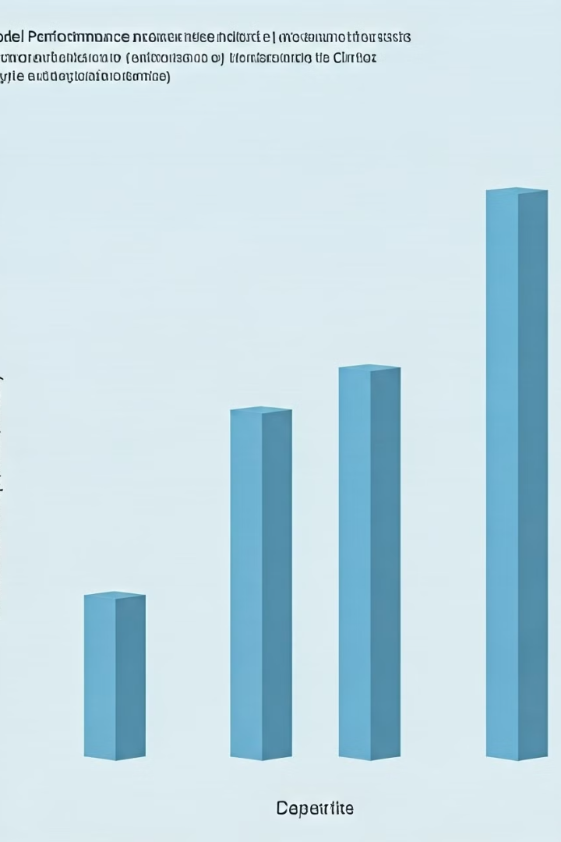
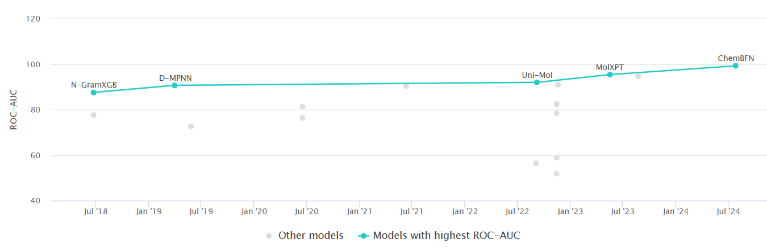
Some Previous Works On Clintox Dataset
Uni-Mol Paper (ROC => 91.90)
MoIXPT Paper (ROC => 95.30)
ChemBFN Paper (ROC => 99.18)
Please refer to this link for a visualtion of latest result comarisons with Paper link:
https://paperswithcode.com/sota/molecular-property-prediction-on-clintox-1

Slide 12

Thank You

